Slide 1


Eigenvalues & eigenvectors, diagonalisation & the Cayley-Hamilton theorem

Slide 2



Slide 3
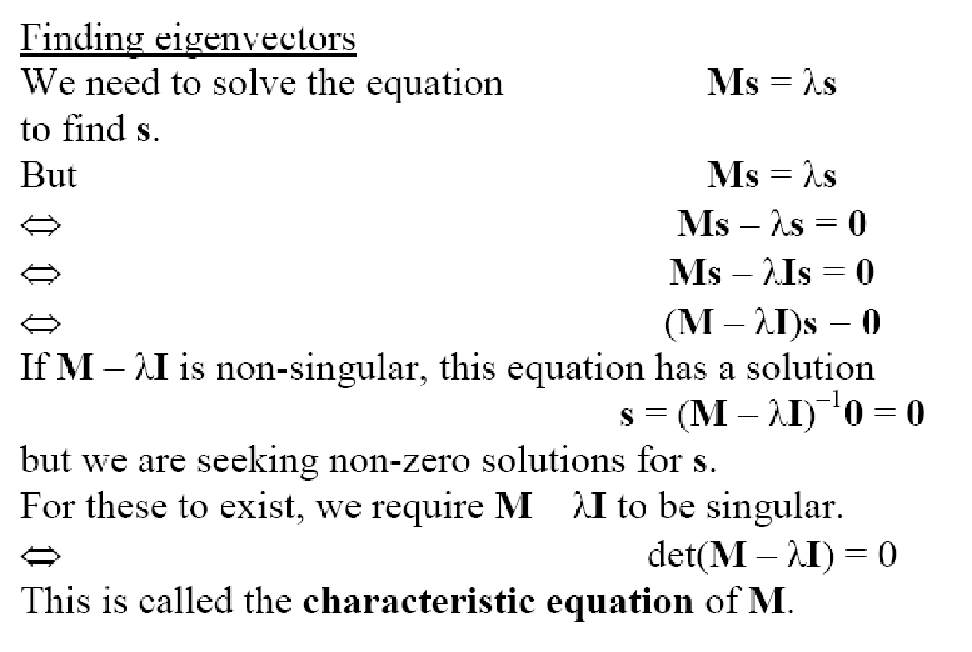

Slide 4



Eigenvalues and Eigenvectors of a 2×2 matrix

Slide 5




Slide 6


Eigenvalues and Eigenvectors of 3×3 matrices

Slide 7


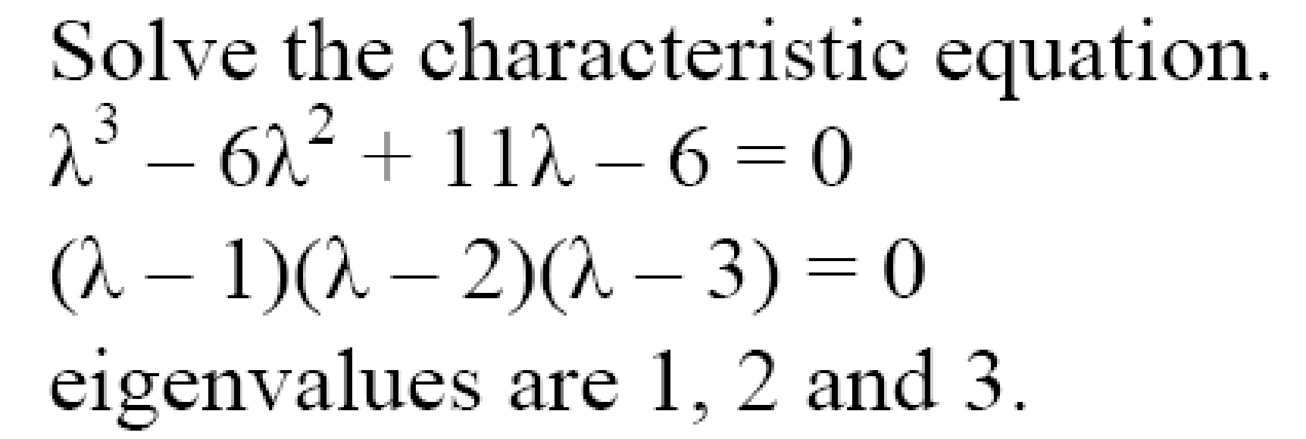

Slide 8

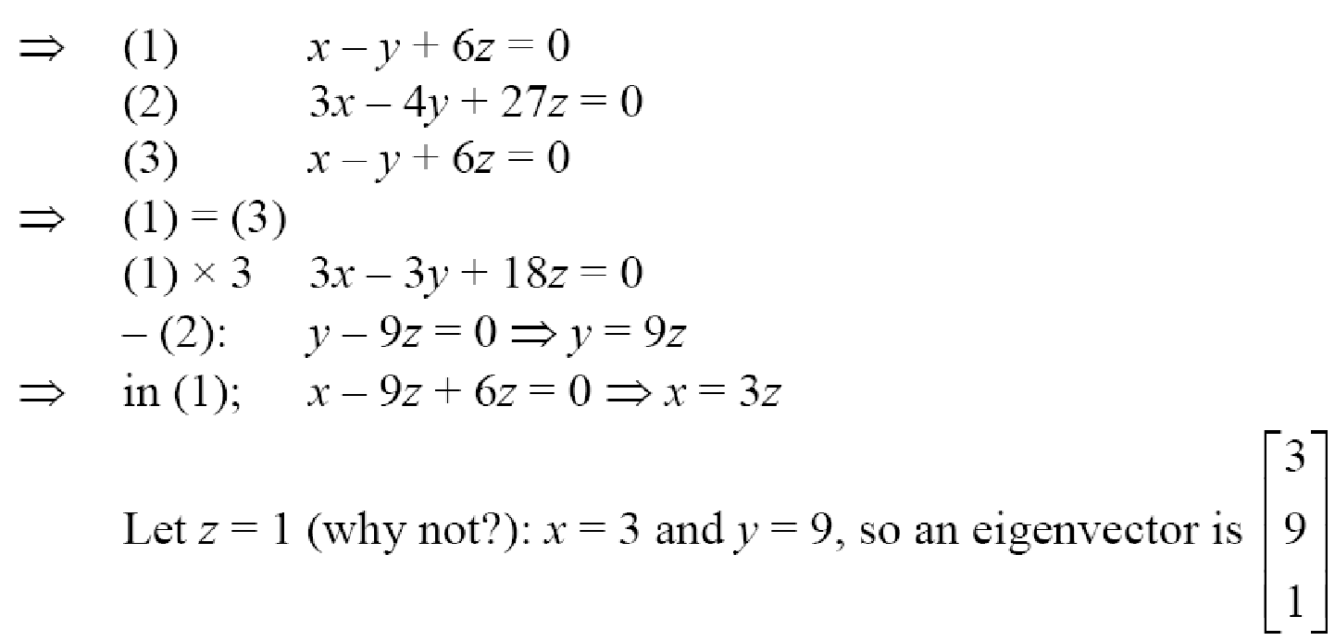

Slide 9
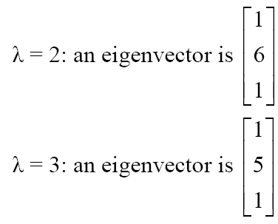


Slide 10




Slide 11
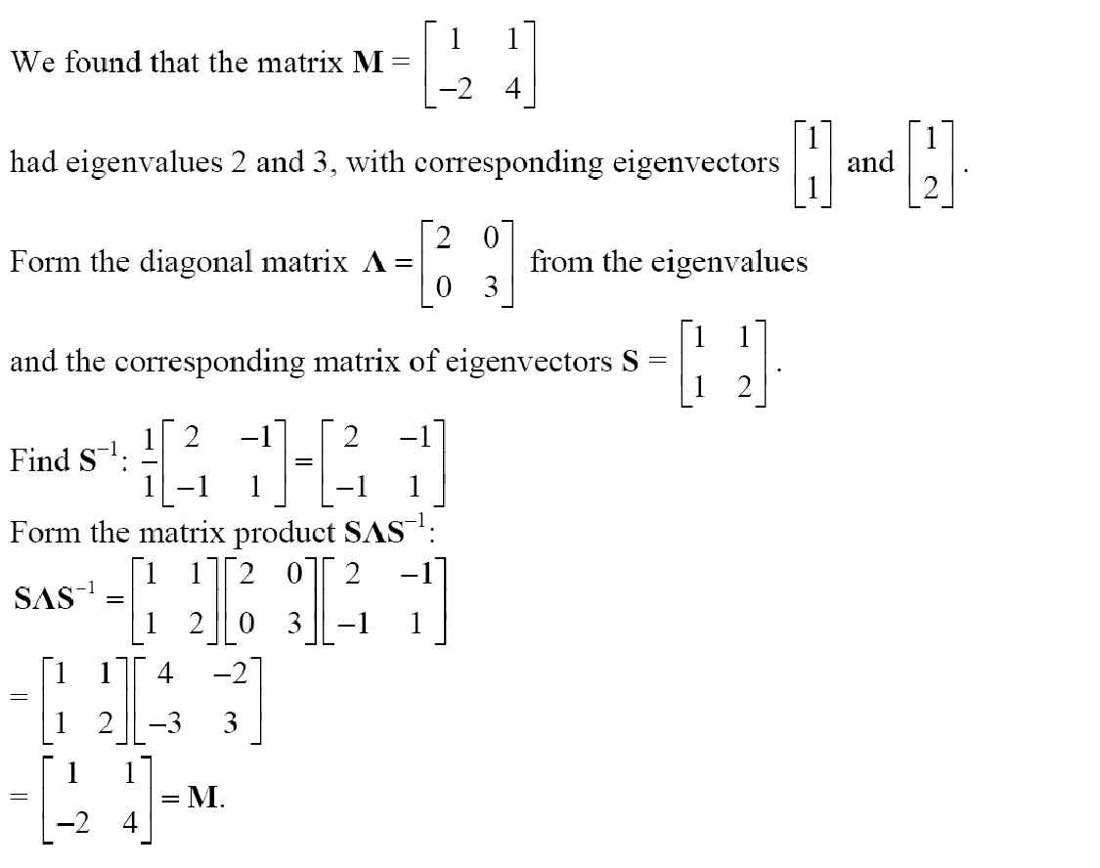
Diagonalisation

Slide 12


Diagonalisation
This is useful for finding powers of matrices

Slide 13



Slide 14
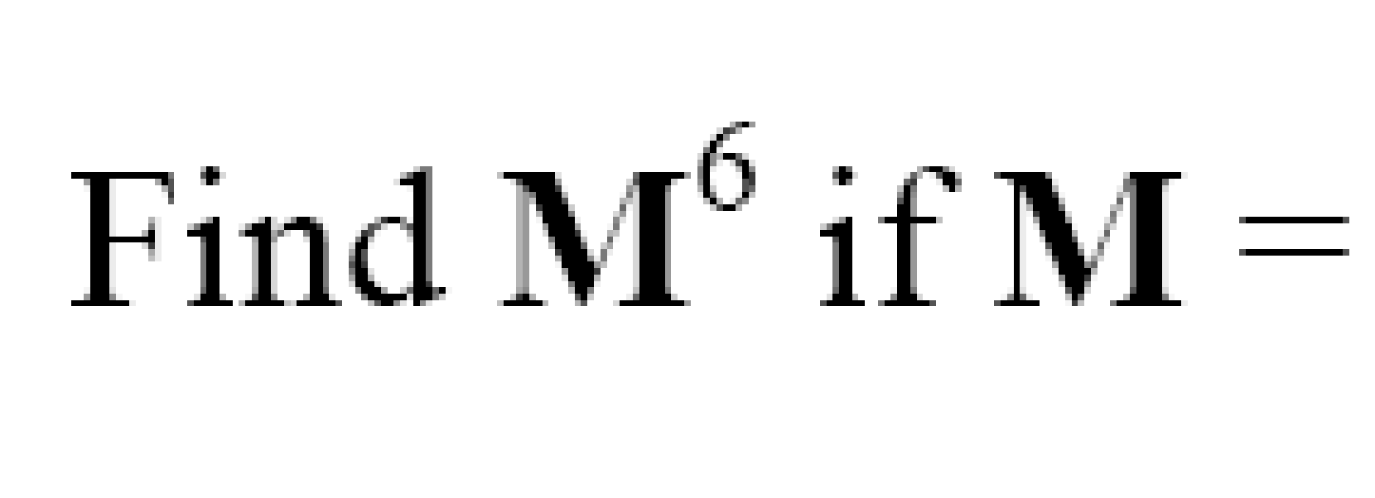
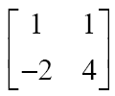



Slide 15



Slide 16
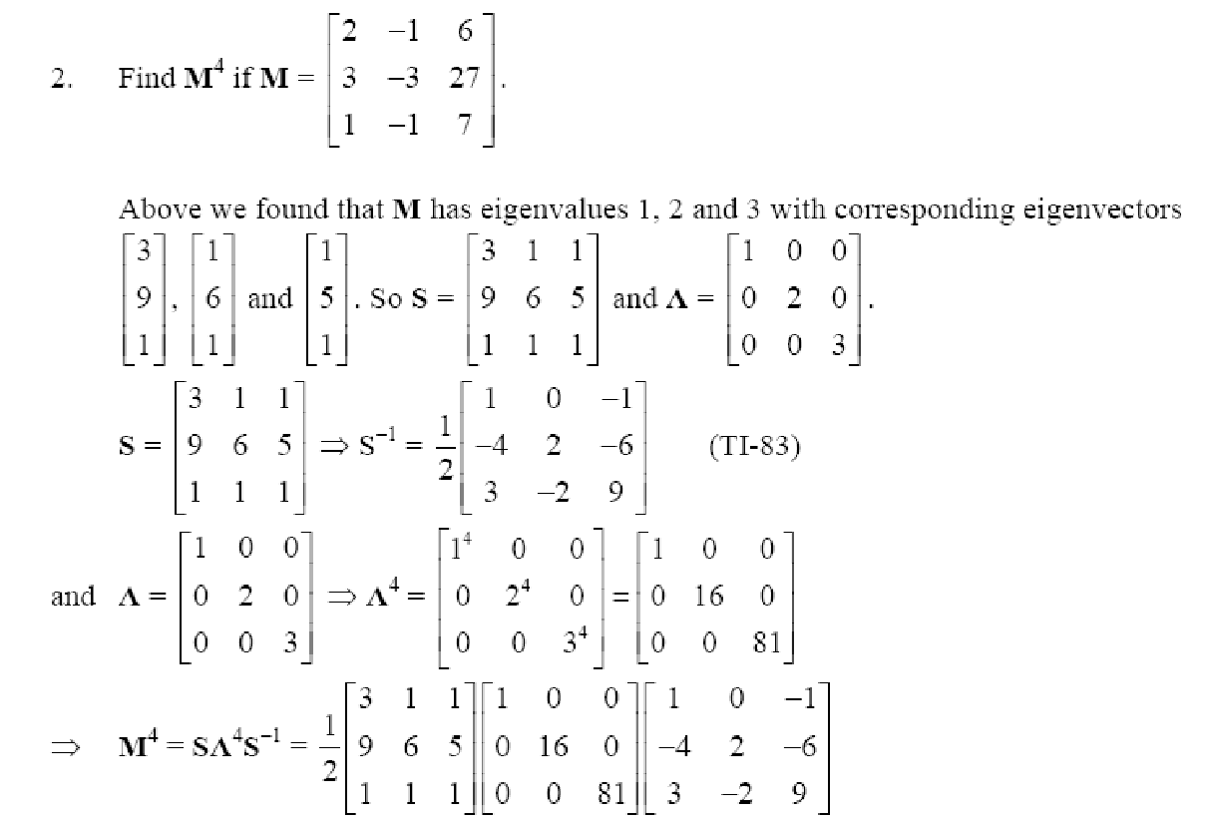
Example
http://www.meiresources.org/test/fp2m1q.pdf

Slide 17
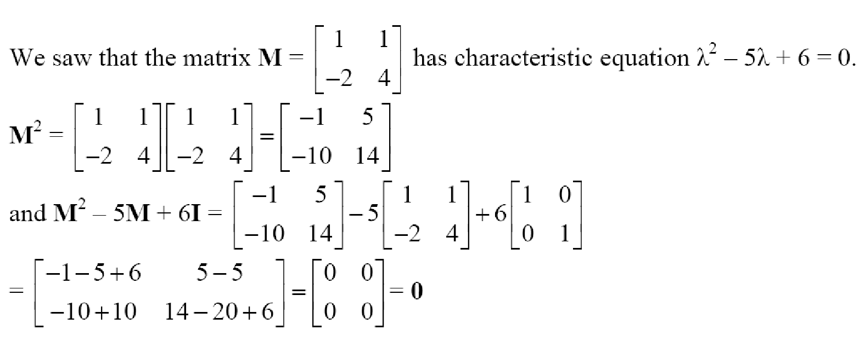

The Cayley Hamilton Theorem

Slide 18


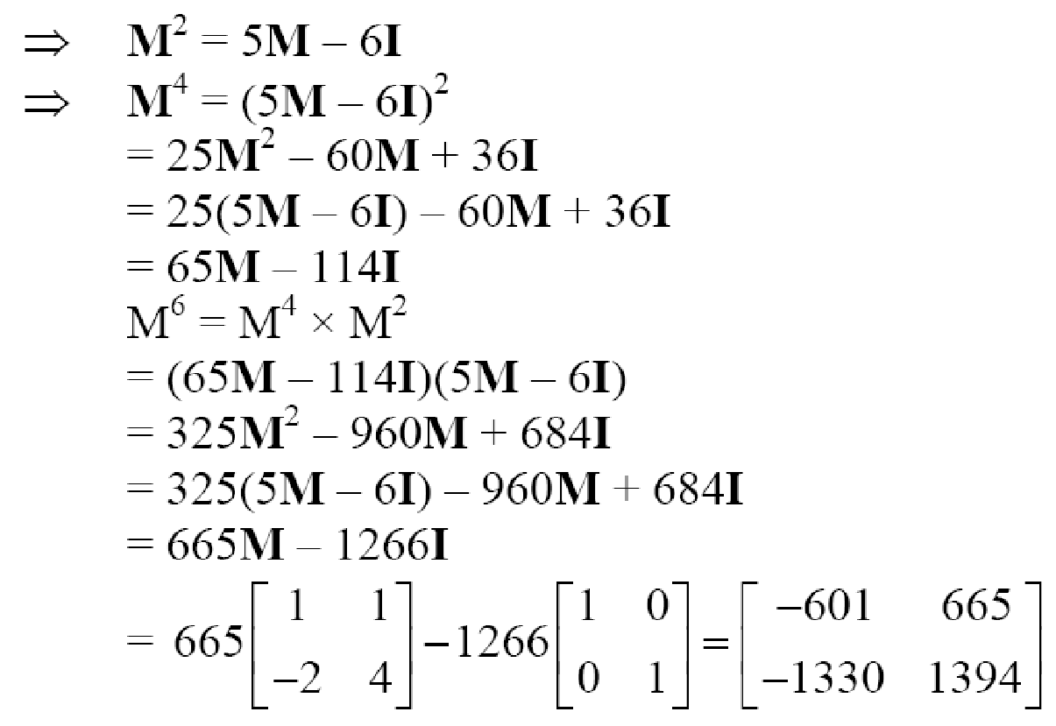

Slide 19

Question

Slide 20

Question

